Slide 1
产品分析报告
for
某食品批发商

Slide 2
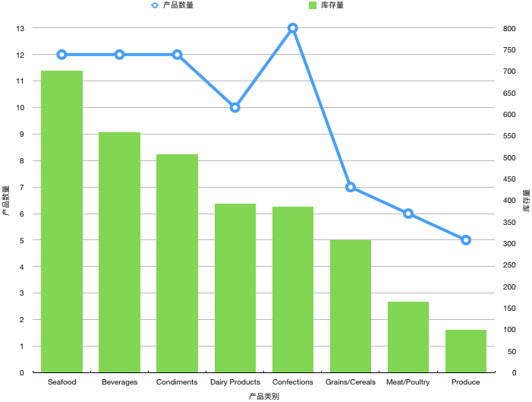
产品种类、库存量概况
目前，我公司共有八大类产品
其中海鲜、饮料、调味品库存量位列前三，产品数量比较丰富
农产品、肉类、谷物类产品数量和库存量偏少
奶制品和甜品库存量适中，甜品数量最多
Notes:
SELECT c.categoryname AS category, COUNT(*) AS number_of_products, SUM(p.unitsinstock) AS stock
FROM Categories c
JOIN Products p
ON c.categoryid=P.categoryid
GROUP BY 1
ORDER BY 3 DESC;

Slide 3
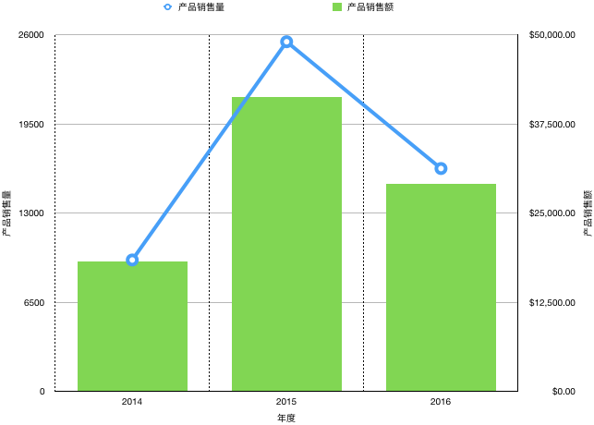
产品销售数量、金额概况
最近三年，我公司产品销售数量和销售金额均稳步增长
其中2015年度产品销售数量和销售金额超过其他年份
2016年度产品销售数量和销售金额虽较2015年度有所回落，但较2014年度增长良好
Notes:
SELECT STRFTIME('%Y', o.orderdate) AS year, SUM(od.quantity*od.unitprice*od.discount) AS order_amount, SUM(od.quantity) AS order_quantity
FROM orders o
JOIN orderdetails od
ON o.orderid=od.orderid
GROUP BY 1
ORDER BY 1;

Slide 4
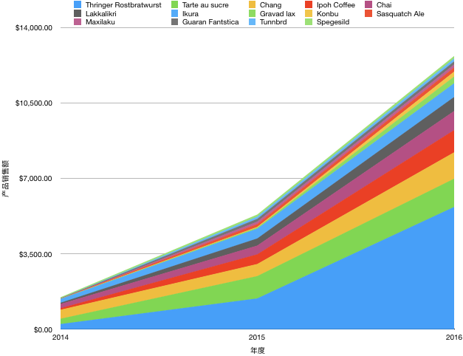
产品销售金额三连增
最近三年，共有14种产品实现销售金额三连增
其中烤肠成为最大爆款产品，销售金额增长最多
甜品、啤酒、咖啡销售金额增长也十分可观
海鲜类实现三连增的产品较少
Notes:
SELECT t1.product_name AS product_name, t1.order_amount AS order_2016, t2.order_amount AS order_2015, t3.order_amount AS order_2014
FROM
(SELECT STRFTIME('%Y', o.orderdate) AS date_2016, p.productname AS product_name, p.productid, SUM(od.quantity*od.unitprice*od.discount)
AS order_amount
FROM orders o
JOIN orderdetails od
ON o.orderid=od.orderid
JOIN products p
ON od.productid=p.productid
WHERE STRFTIME('%Y', o.orderdate)='2016'
GROUP BY 2
ORDER BY 3 DESC) t1
JOIN
(SELECT STRFTIME('%Y', o.orderdate) AS date_2015, p.productname, p.productid, SUM(od.quantity*od.unitprice*od.discount) AS order_amount
FROM orders o
JOIN orderdetails od
ON o.orderid=od.orderid
JOIN products p
ON od.productid=p.productid
WHERE STRFTIME('%Y', o.orderdate)='2015'
GROUP BY 2
ORDER BY 3 DESC) t2
ON t1.productid=t2.productid
JOIN
(SELECT STRFTIME('%Y', o.orderdate) AS date_2014, p.productname, p.productid, SUM(od.quantity*od.unitprice*od.discount) AS order_amount
FROM orders o
JOIN orderdetails od
ON o.orderid=od.orderid
JOIN products p
ON od.productid=p.productid
WHERE STRFTIME('%Y', o.orderdate)='2014'
GROUP BY 2
ORDER BY 3 DESC) t3
ON t2.productid=t3.productid
WHERE order_2016>order_2015 AND order_2015>order_2014
GROUP BY 1
ORDER BY 2 DESC

Slide 5
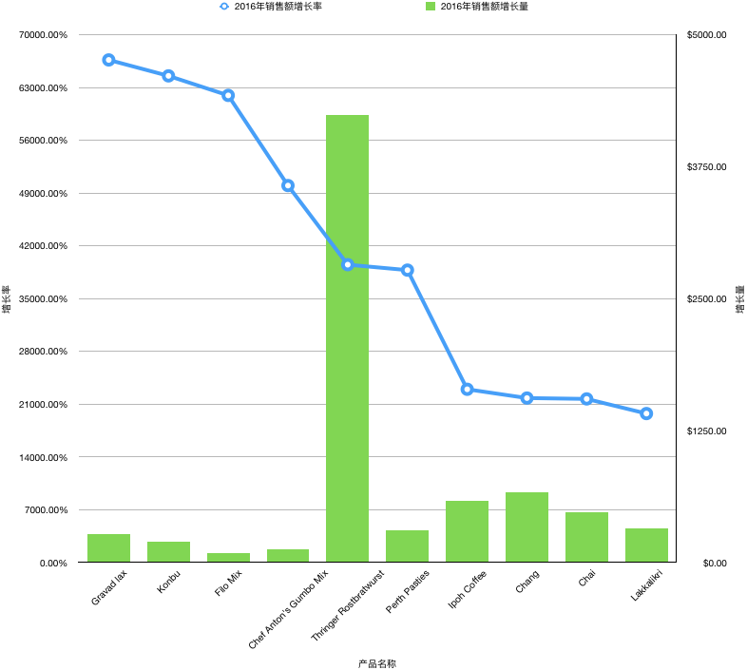
产品销售金额增长率 TOP 10
2016年度销售金额增长率TOP 10 榜单涌现一些爆款新品
甜品、饮料等销售金额实现三连增的主打产品，增长率也进入前十名
Gravad lax成为最大新品
甜品、饮料等休闲食品增长强劲，可考虑适当调整我公司的产品数量和库存量
Notes:
SELECT product_name AS product_name, SUM(order_2016-order_2015) AS sale_increase_2016, (order_2016)*100/(order_2015) AS percent_increase_2016
FROM
(SELECT t1.product_name AS product_name, t1.order_amount AS order_2016, t2.order_amount AS order_2015
FROM
(SELECT STRFTIME('%Y', o.orderdate) AS date_2016, p.productname AS product_name, p.productid, SUM(od.quantity*od.unitprice*od.discount)
AS order_amount
FROM orders o
JOIN orderdetails od
ON o.orderid=od.orderid
JOIN products p
ON od.productid=p.productid
WHERE STRFTIME('%Y', o.orderdate)='2016'
GROUP BY 2
ORDER BY 3 DESC) t1
JOIN
(SELECT STRFTIME('%Y', o.orderdate) AS date_2015, p.productname, p.productid, SUM(od.quantity*od.unitprice*od.discount) AS order_amount
FROM orders o
JOIN orderdetails od
ON o.orderid=od.orderid
JOIN products p
ON od.productid=p.productid
WHERE STRFTIME('%Y', o.orderdate)='2015'
GROUP BY 2
ORDER BY 3 DESC) t2
ON t1.productid=t2.productid) t3
GROUP BY 1
ORDER BY 3 DESC
LIMIT 10

